Slide 1
Data Model Components
A data Model is an Integrated collection of concepts for describing data, relationships between data, and constraints on the data in an organization.
Purpose - To represent data in an understandable way.
Data Model comprises:
  a structural part;
  a manipulative part;
  possibly a set of integrity rules.

Slide 2
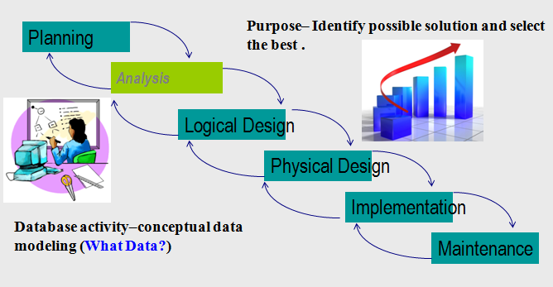
Recall….Database development process…
Analysis → Conceptual data modelling - ER model (today)
What Data?
Logical Design → relations (next time)
How is the data manipulated?

Slide 3
Categories of data models
Record-Based Data Models
  Entity Relational Data Model
  Network Data Model
  Hierarchical Data Model.
Object-Based Data Models
  Entity-Relationship
  Semantic
  Functional
  Object-Oriented.
Physical Data Models

Slide 4
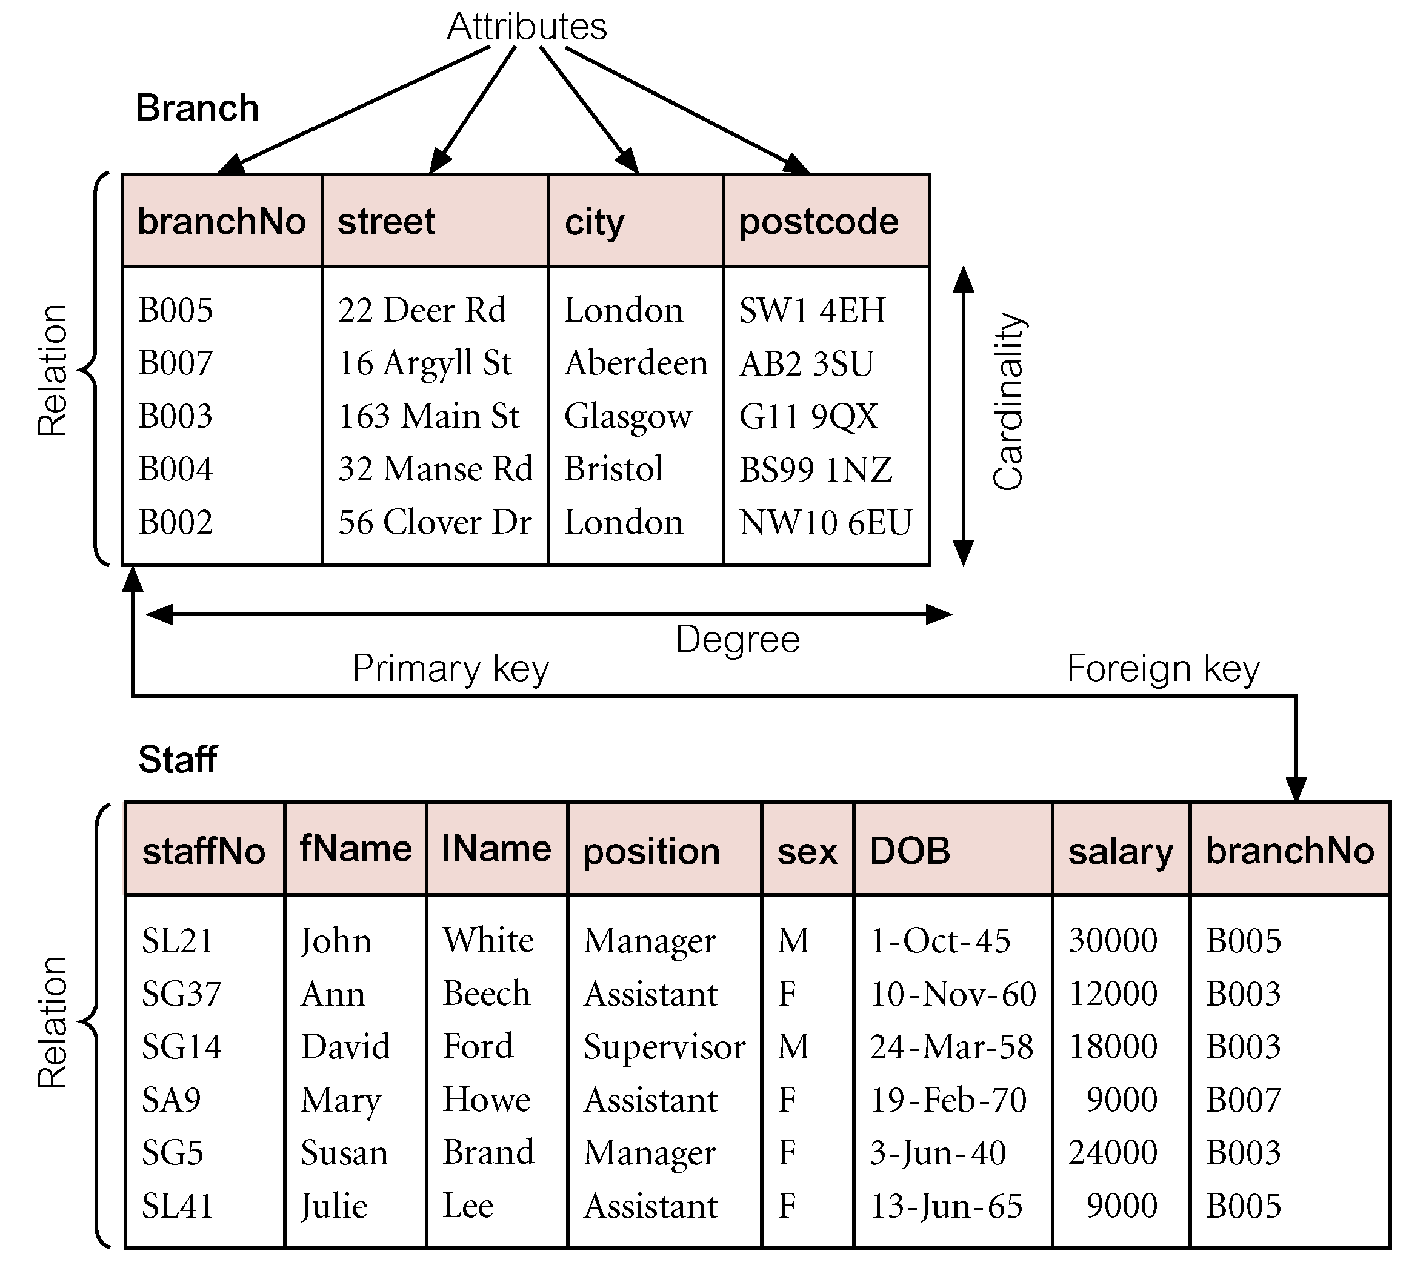
Relational Model - Definition of Terms
A table (Entity/Relation) A person, place, event, or thing about which data is collected
Attribute (Field/Column) is a characteristic of an entity.
Domain (Data Dictionary/Meta data) is the set of allowable values for one or more attributes. Found in the Data Dictionary
Tuple (row/record) of a relation.
Degree is the number of attributes in a relation.
Cardinality is the number of tuples in a relation

Slide 5
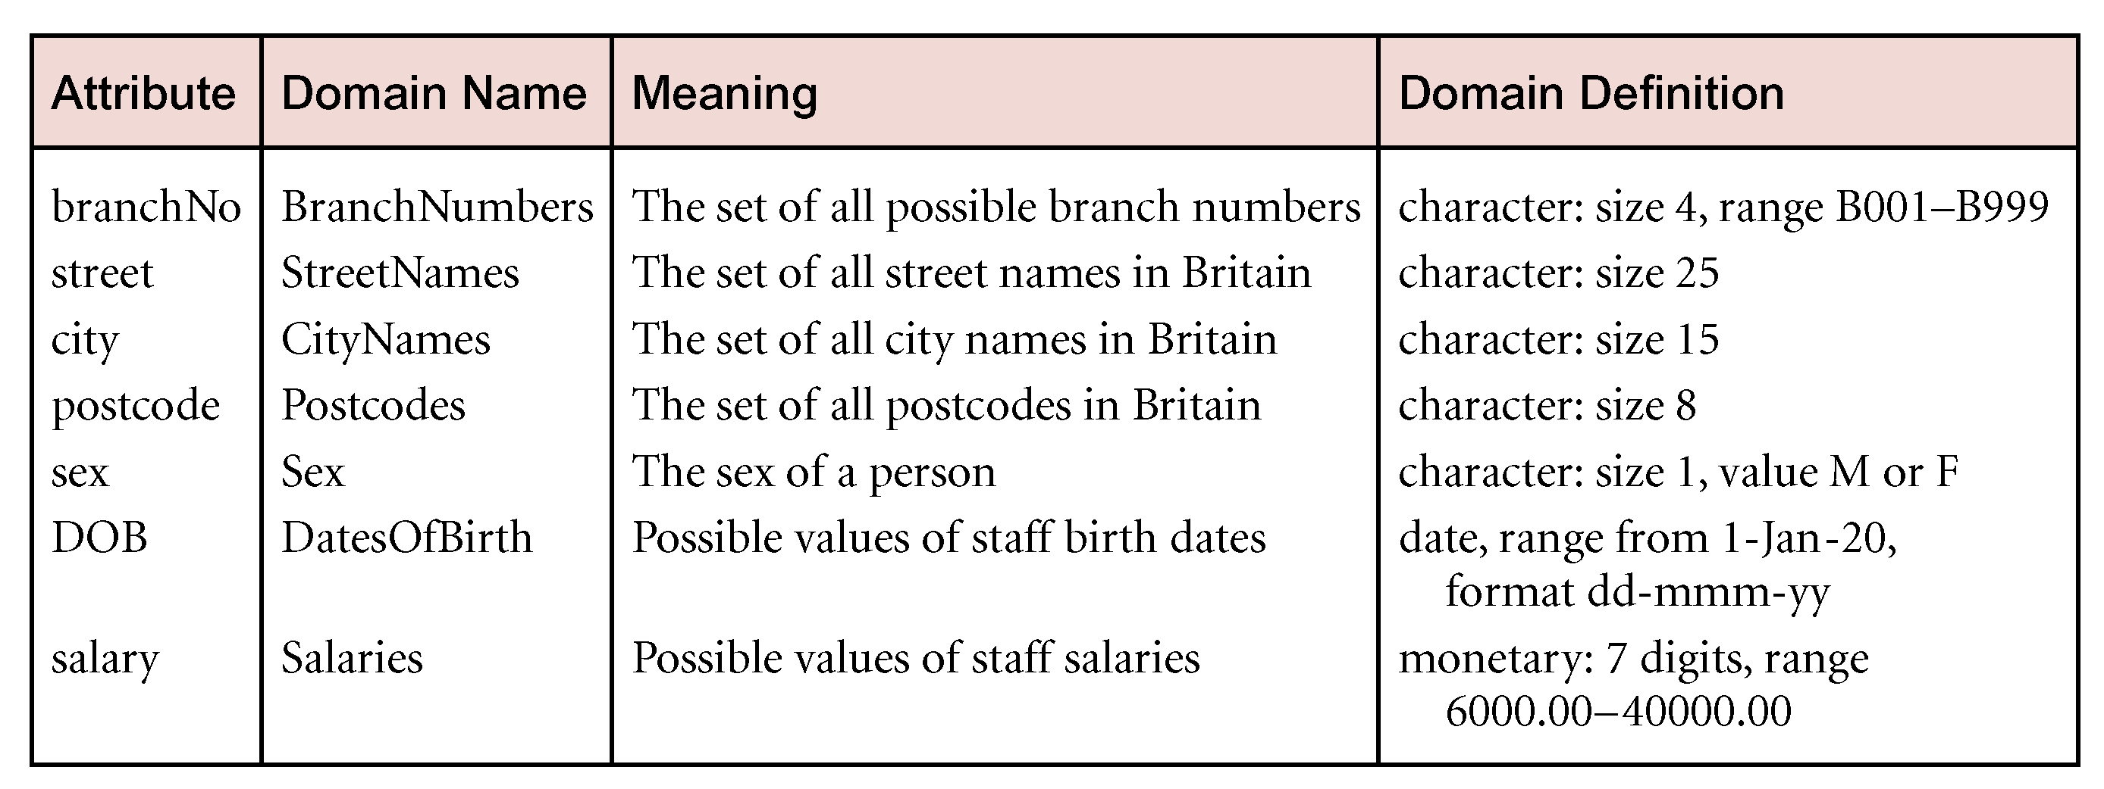
Examples of Attribute Domains

Slide 6
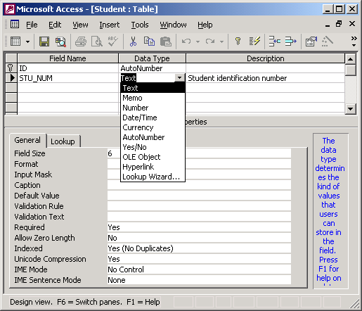
Implementing Attribute Domains

Slide 7
Developing a DBMS for StayHome
1. Database planning – Identify the purpose:
The purpose of the StayHome database system is to collect, store, manage, and control access to the data that supports the video rentals business for our members, and to facilitate the corporation and sharing of information between branches.
This information is obtained from the managers of the organization

Slide 8
2. Analysis – Conceptual modelling → Develop ER Diagram
Procedure:
Identify entities,
Identify relationships,
Establish Cardinality degree and constraints
Identify attributes & keys,
Identify integrity constraints.

Slide 9
1. Identify Entities
Entities:
  Entity instance–person, place, object, event, concept (often corresponds to a row in a table)
  Entity Type–collection of entities (often corresponds to a table)
Exercise – List the entities for StayHome Rental

Slide 10
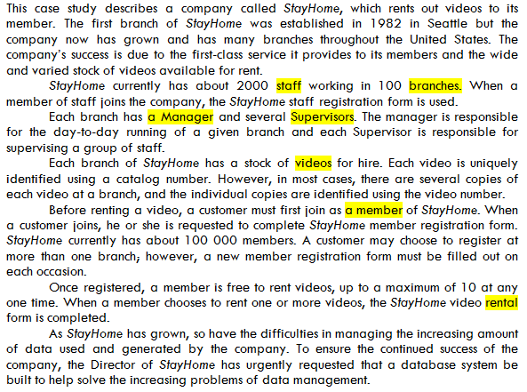
List of entities:
Branch
Staff
Manager
Supervisor
Video
Member

Slide 11
CH4: DATA MODELING
Entity names and attribute names are the names that you will give to your data
A Good Data Name Is:
Related to business, not technical, characteristics
Meaningful and self-documenting
Unique
Readable
Composed of words from an approved list
Follows standard syntax

Slide 12
CH4: DATA MODELING
An entity
SHOULD BE:
  An object that will be composed of multiple attributes
SHOULD NOT BE:
  A user of the database system
  An output of the database system (e.g., a report)

Slide 13
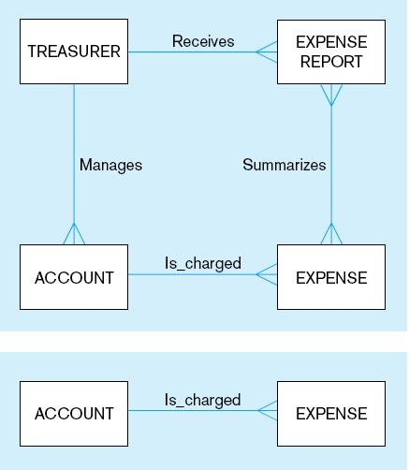
System
user
System output
Inappropriate entities
Example of inappropriate entities
Appropriate entities

Slide 14
2. Identify Relations
  Relationship instance–link between entities (corresponds to primary key-foreign key equivalencies in related tables)
  Relationship type–category of relationship…link between entity types

Slide 15
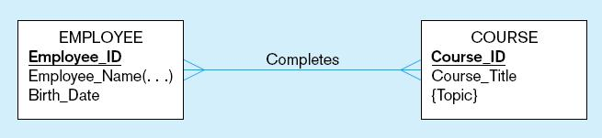
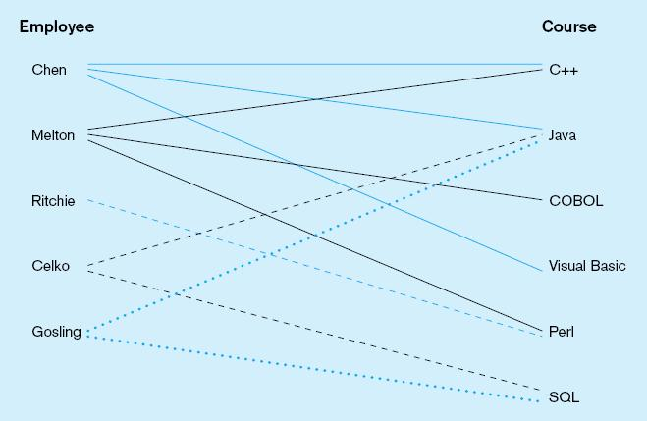
Relationship types and instances
a) Relationship type
lines between
entity types
b) Relationship
instances
between specific
entity instances
Notes:
17

Slide 16
staff working in 100 branches
branch has a Manager
Branch has several Supervisors
Supervisor is responsible for staff.
Branch of StayHome has a stock of videos
Customer register at branch
member is free to rent videos
Exercise – Draw the ther relationships for StayHome Rental
Staff
Works
Branch

Slide 17
CH4: DATA MODELING
Relations are derived from business rules
A Good Business Rule Is:
Declarative–what, not how
Precise–clear, agreed-upon meaning
Atomic–one statement
Consistent–internally and externally
Expressible–structured, natural language
Distinct–non-redundant
Business-oriented–understood by business people

Slide 18
3. Establish Cardinalities and Existence

Slide 19
Cardinality of Relationships
Cardinality – Degree
1:1
1:M or M:1
M:M
Exercise – Insert Cardinalities for the StayHome rental relations
Staff
Works
Branch
M:1

Slide 20
branch has a Manager – Problem?
Solution – Combine
member is free to rent videos – Problem?
Solution – Introduce Associative Entity
Branch
Has a
Manager
1:1
Member
rents
Video
M:M

Slide 21
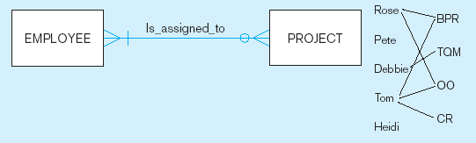
Associative Entities
  When there is a many-to-many cardinality between entities an associative entity is introduced to make the relationship I:M
Usually the relationship description will guide you on what associative entity to introduce
Example:
Solution
Takes
For
Employee
Assignment
Project

Slide 22
Exercise – Solve any 1:1 or M:M problems in the Stayhome Case study

Slide 23
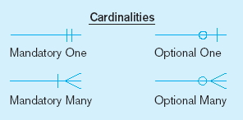
Cardinality Constraints
Refers to the number of instances of one entity that can or must be associated with each instance of another entity
Optional - If it can be zero
Mandatory - If one or more
Notes:
29

Slide 24
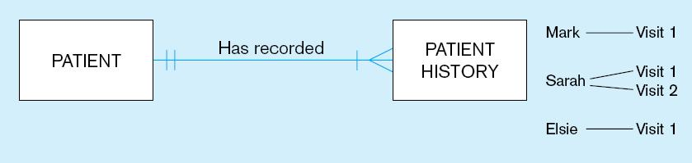
a) Mandatory cardinalities
A patient history is recorded for one and only one patient
A patient must have recorded at least one history, and can have many
Notes:
1

Slide 25
b) Optional cardinalities
A project must be assigned to at least one employee, and may be assigned to many
An employee can be assigned to any number of projects, or may not be assigned to any at all
Notes:
1

Slide 26
For the StayHome Case study...
Exercise - Indicate the cardinality constraints for the remaining entities.
Staff
Works
Branch

Slide 27
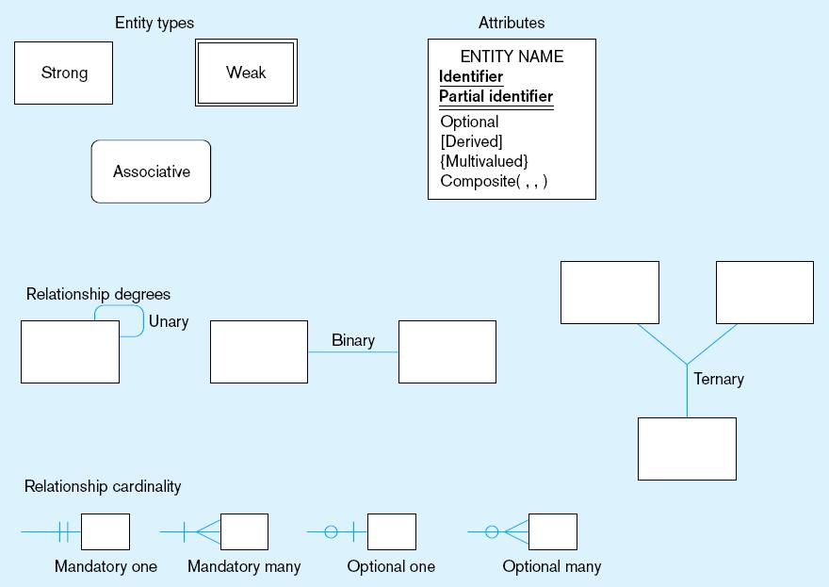
Entity Types

Slide 28
Strong vs. Weak Entities, and
Identifying Relationships
Strong entities
  exist independently of other types of entities
  has its own unique identifier
  identifier underlined with single line
Weak entity
  dependent on a strong entity (identifying owner)…cannot exist on its own
  does not have a unique identifier (only a partial identifier)
  partial identifier underlined with double line
  entity box has double line
Identifying relationship
  links strong entities to weak entities

Slide 29
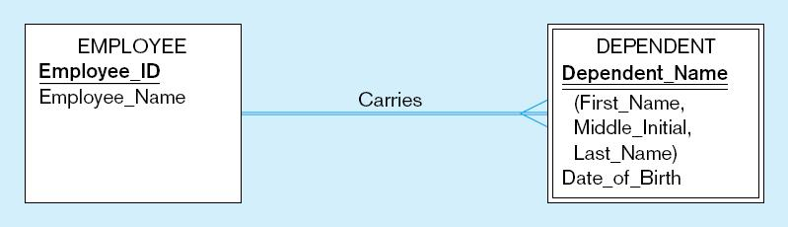
Identifying relationship
Strong entity
Weak entity

Slide 30
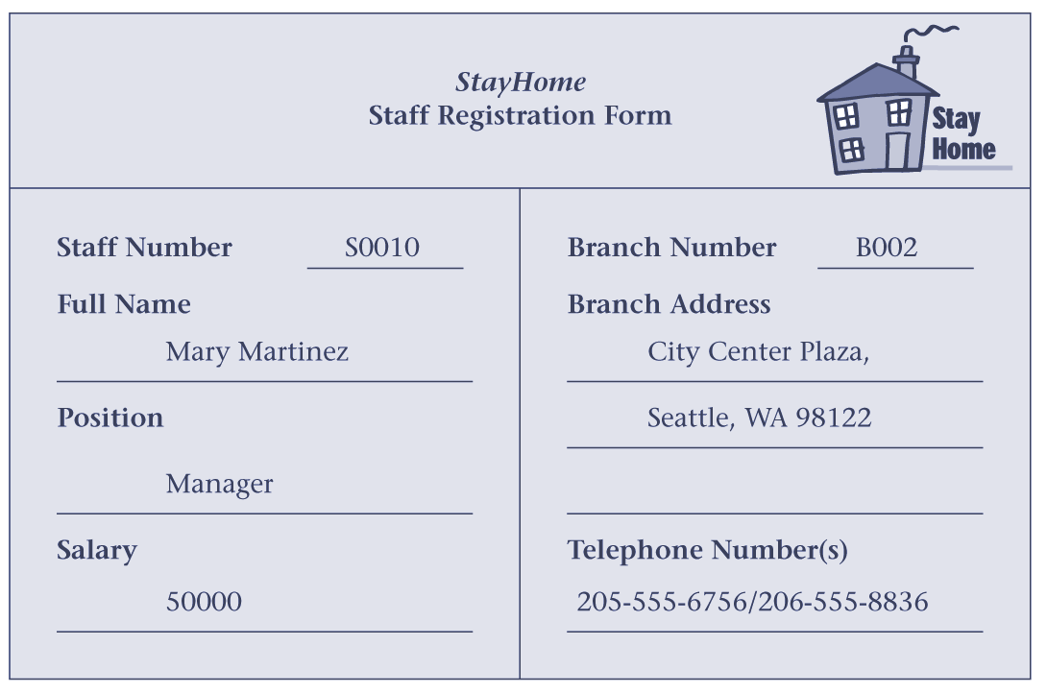
4. Identify attributes
Identify Primary Key
Identify Foreign Key
STAFF
Sno
Sname
Position
Salary
BrNo
BRANCH
BrNo
Baddress
TelNo
Works

Slide 31
Attribute–property or characteristic of an entity or relationship type
Classifications of attributes:
  Required versus Optional Attributes
  Simple versus Composite Attribute
  Single-Valued versus Multivalued Attribute
  Stored versus Derived Attributes
  Identifier Attributes
Notes:
5

Slide 32
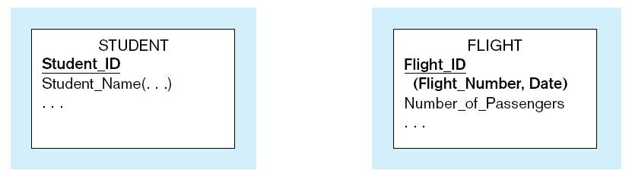


Simple and composite identifier attributes
The identifier is boldfaced and underlined
Notes:
14

Slide 33
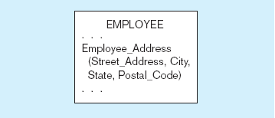
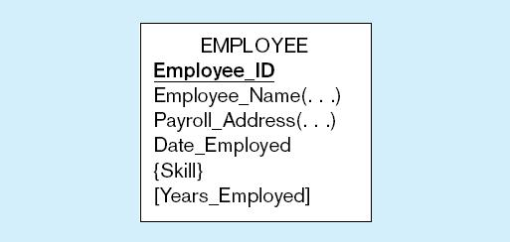
A composite attribute
An attribute broken into component parts
Entity with multivalued attribute (Skill)
and derived attribute (Years_Employed)
Derived
from date employed and current date
Multivalued
an employee can
Have more than
one skill
Notes:
12

Slide 34
Key attribute - One or more attributes that determine other attributes
Primary Key - Candidate key selected to identify tuples uniquely within relation.
Composite Key – Candidate key made up of one or more keys
Alternate Keys - Candidate keys that are not selected to be primary key.
Foreign Key - Attribute, or set of attributes, within one relation that matches primary key(s) of some relation.

Slide 35
Functional Dependence
There needs to be a functional dependence between the primary key and other attribute
An attribute A is said to be functionally dependent on an attribute K if each value in column K determines a value in column A.

Slide 36
Exercise
Identify attributes for the remaining entities from Ch 2 lecture notes
Update your Entity Relationship Diagrams
Join your Entity Relationship Diagrams

Slide 37
Relational Integrity
5. Identify relational integrity constraints such as:
Entity Integrity -
  In a base relation, no attribute of a primary key can be null.
  Ensures that all entities are unique.
Referential Integrity
  If foreign key exists in a relation, either foreign key value must match a primary key value of some tuple in its home relation or foreign key value must be wholly null.

Slide 38
Properties of Relations
Relation name is distinct from all other relation names in relational schema.
Each cell of relation contains exactly one atomic (single) value. I.e. its unique.
Each attribute has a distinct name.
Values of an attribute are all from the same domain.
Each tuple/row is distinct; there are no duplicate tuples.
Order of attributes has no significance.
Order of tuples has no significance, theoretically.

Slide 39
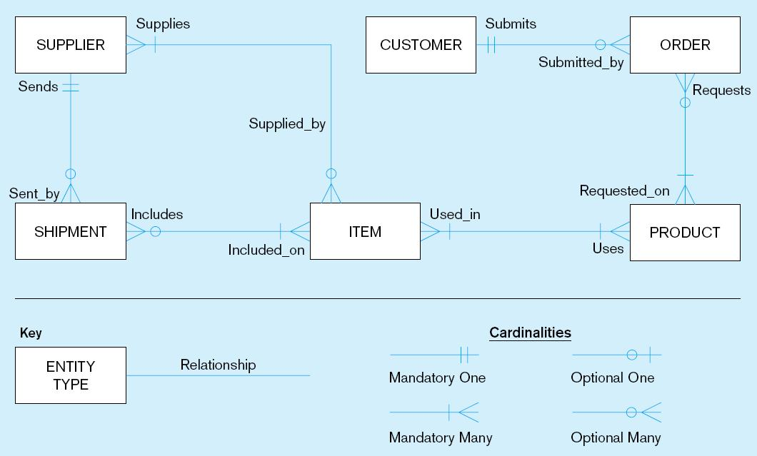
Sample E-R Diagram
Notes:
3

Slide 40
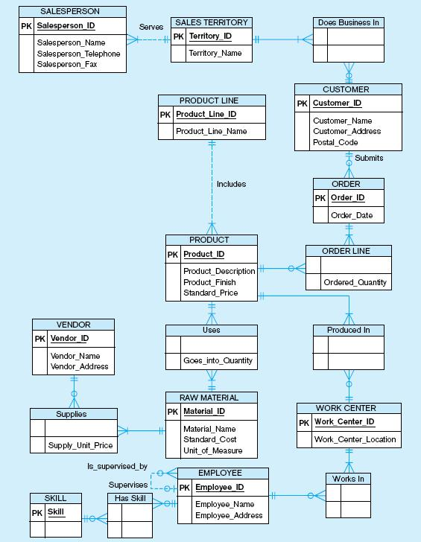

Slide 41
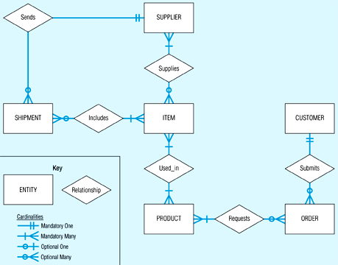
Sample E-R Diagram

Slide 42
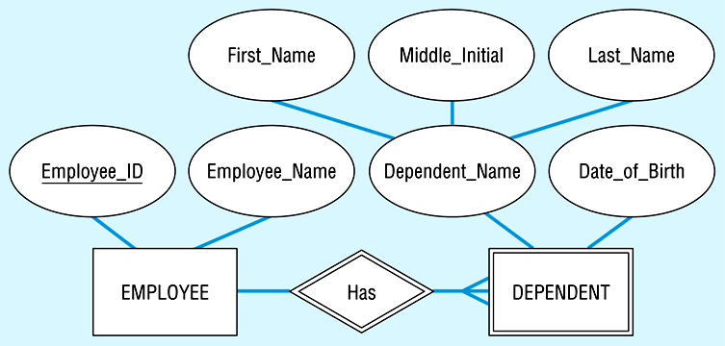
Sample E-R Diagram

